Slide 1

DIGITAL PORTFOLIO
STUDENT NAME:DHARSAN.S
REGISTER NO AND NMID:2422K1932/asbru062422k1932
DEPARTMENT:B SC COMPUTER SCIENCE
COLLEGE: CHIKKANNA GOVERNMENT ARTS AND SCIENCE
UNIVERSITY: BHARATHIYAR UNIVERSITY

Slide 2


PROJECT TITLE
APR FITNESS
PORTFOLIO?

Slide 3

AGENDA
Problem Statemen
Project Overview
End Users
Tools and Technologies
Portfolio design and Layout
Features and Functionality
Results and Screenshots
Conclusion
Github Link

Slide 4


PROBLEM STATEMENT
Many individuals struggle to stay consistent with
their fitness journey due to lack of proper
guidance, structured workout plans, and
personalized diet charts.

Slide 5


PROJECT OVERVIEW
APRFITNESS PROVIDES PERSONALIZED WORKOUT
SCHEDULES, DIET PLANS, AND TRACKING TOOLS TO HELP
INDIVIDUALS ACHIEVE REAL TRANSFORMATION.

Slide 6
WHO ARE THE END USERS?
FITNESS ENTHUSIASTS?
BEGINNERS IN FITNESS?
ATHLETES AND BODYBUILDERS?
PEOPLE AIMING FOR WEIGHT GAIN, FAT LOSS, OR
STRENGTH BUILDING

Slide 7


TOOLS AND TECHNIQUES
TOOLS:THE TOOLS I HAVE USED IN THIS DIGITAL PORTFOLIO IS
HTML5, CSS, JAVASCRIPT, FIRE FOX AND CODEPEN FOR CODE
EDITOR.
TECHNIQUES:I USED SEMANTIC TAGS LIKE <NAV>
,
<HEAD>
,
<FOOTER> FOR BETTER READABILITY. I USED EXTERNAL CSS FOR
ADDING STYLES TO MY PORTFOLIO. I USED JAVASCRIPT TO GIVE
A POPUP MESSAGE AFTER SUBMITTING A MESSAGE IN MY
CONTACT WHICH WAS IN FORM AND VALIDATION. I ALSO USED
JAVASCRIPT FOR SMOOTH NAVIGATION.
(FOR PORTFOLIO DESIGN)?
FITNESS KNOWLEDGE &TRAINING METHODS?
ONLINE PLATFORMS FOR CLIENT INTERACTION

Slide 8
POTFOLIO DESIGN AND LAYOUT
THE WEBSITE IS DESIGNED WITH A MODERN LAYOUT,
GRADIENT BACKGROUNDS, NAVIGATION BAR, INTERACTIVE
SECTIONS LIKE ABOUT, PLANS, PROJECTS, AND CONTACT.

Slide 9
FEATURES AND FUNCTIONALITY
CUSTOMWORKOUT SCHEDULES?
PERSONALIZEDDIET PLANS?
REP COUNT &TRACKING?
SPECIAL PLANS FOR ATHLETES &BODYBUILDERS?
CONTACT FORMFOR DIRECT COMMUNICATION?

Slide 10

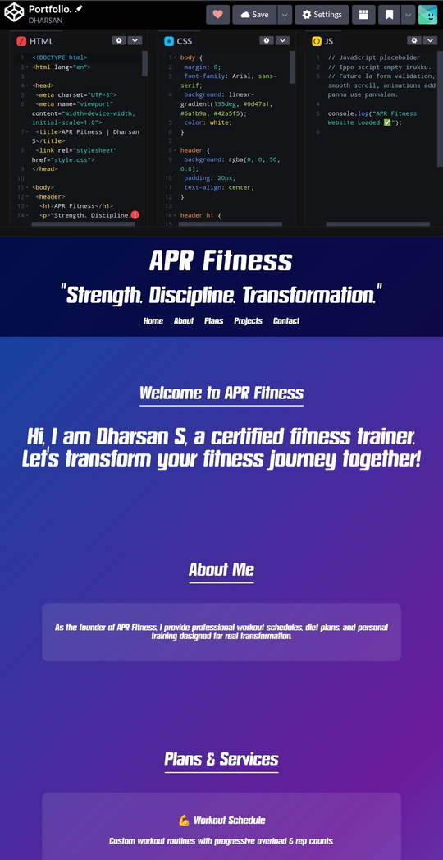
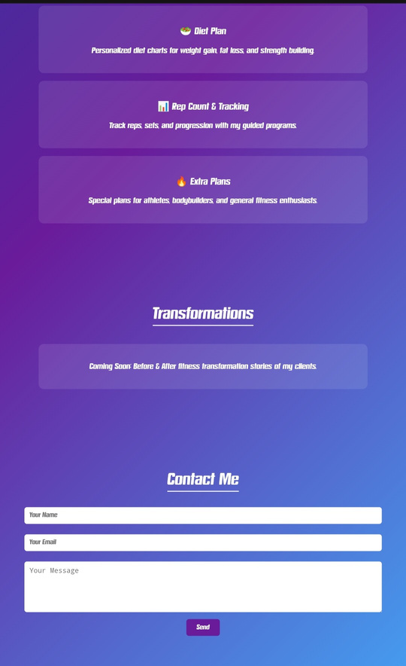
RESULTS AND SCREENSHOTS

Slide 11

CONCLUSION
APRFITNESS IS A PERSONALIZED FITNESS PLATFORM
DESIGNED TO PROVIDE PROPER GUIDANCE, DISCIPLINE,
AND STRUCTURED PLANS FOR TRANSFORMATION.

Slide 12
Thank You!
CREATED
BY
DHARSAN.S

